Slide 1

French Euro
Made by Aniket Dixit, Class- VIII-A, Sunder Deep World School

Slide 2
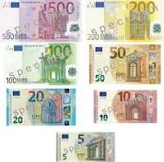
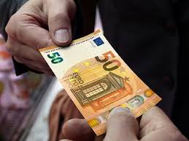
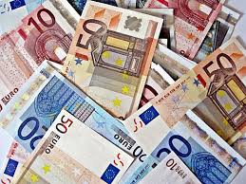
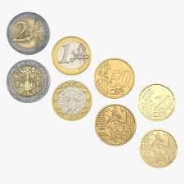
France’s Currency is ‘EURO’
French Euro Coins feature three separate designs for the three series of coins. The major two coins are by Joaquin Jimenez. All designs share the 12 states of the EU and the year of the imprint as well as the letters “RF” for République Française (French Republic)

Slide 3
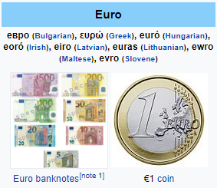
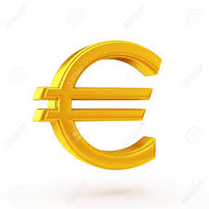
About ‘Euro’
The Euro (sign €; code: EUR) is the official currency of 19 of the 28 member states of the European Union. This group of states is known as the eurozone or euro area, and counts 343 million citizens as of 2019. The euro is the second largest and second most traded currency in the foreign exchange market after the United States Dollar. The Euro is divided into 100 cents.

Slide 4



THANK YOU FOR WATCHING!!! ☺☺☺☺☺

